Slide 1
Lecture 7
The Level Set Approach for Turbulent Premixed Combustion:
A common G – equation for both regimes
12.-1

Slide 2
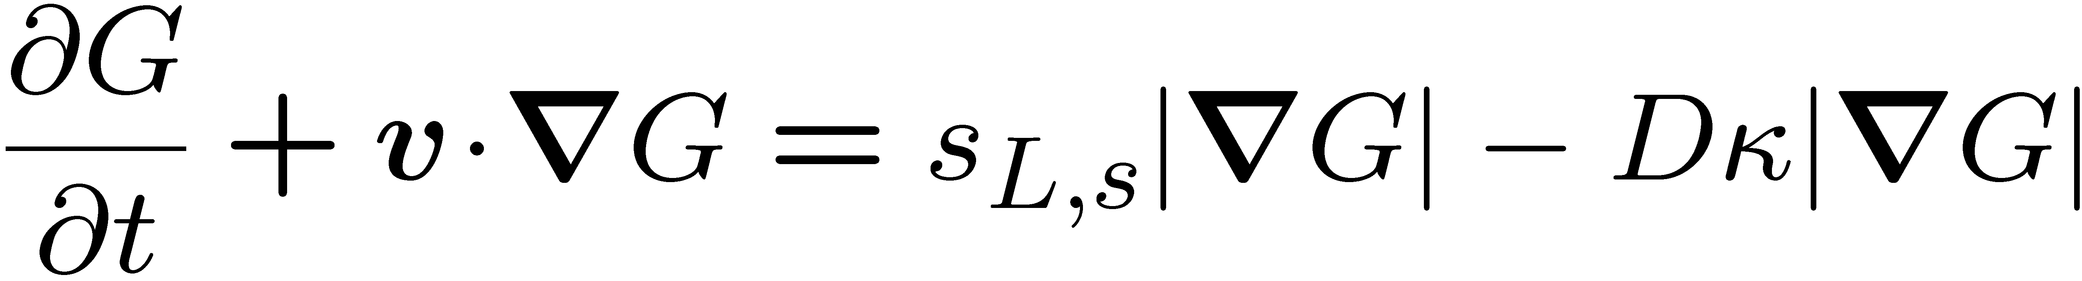
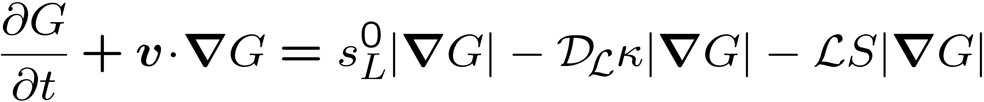
A Common Level Set Equation for Both Regimes
The G-equation applies to different regimes in premixed turbulent combustion:
corrugated flamelets regime
thin reaction zones regime
In order to show this we will analyze the order of magnitude of the different terms in the first equation.
12.-35

Slide 3
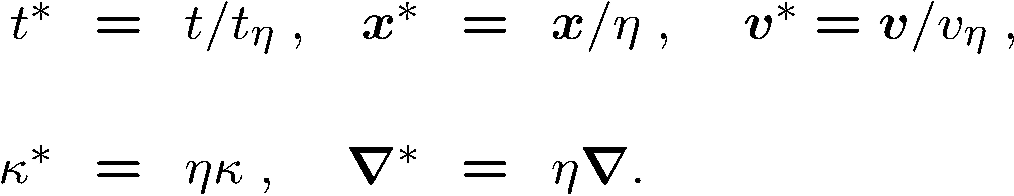
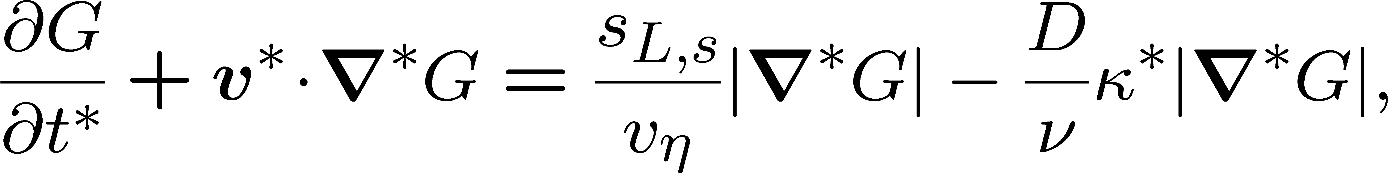
This can be done by normalizing the independent variables and the curvature in this equation with respect to Kolmogorov length, time and velocity scales
Using η²/t_{η} = ν one obtains
Since Kolmogorov eddies can perturb the flow field as well as the G-field, all derivatives, the curvature and the velocity v* are typically of order unity.
12.-36

Slide 4
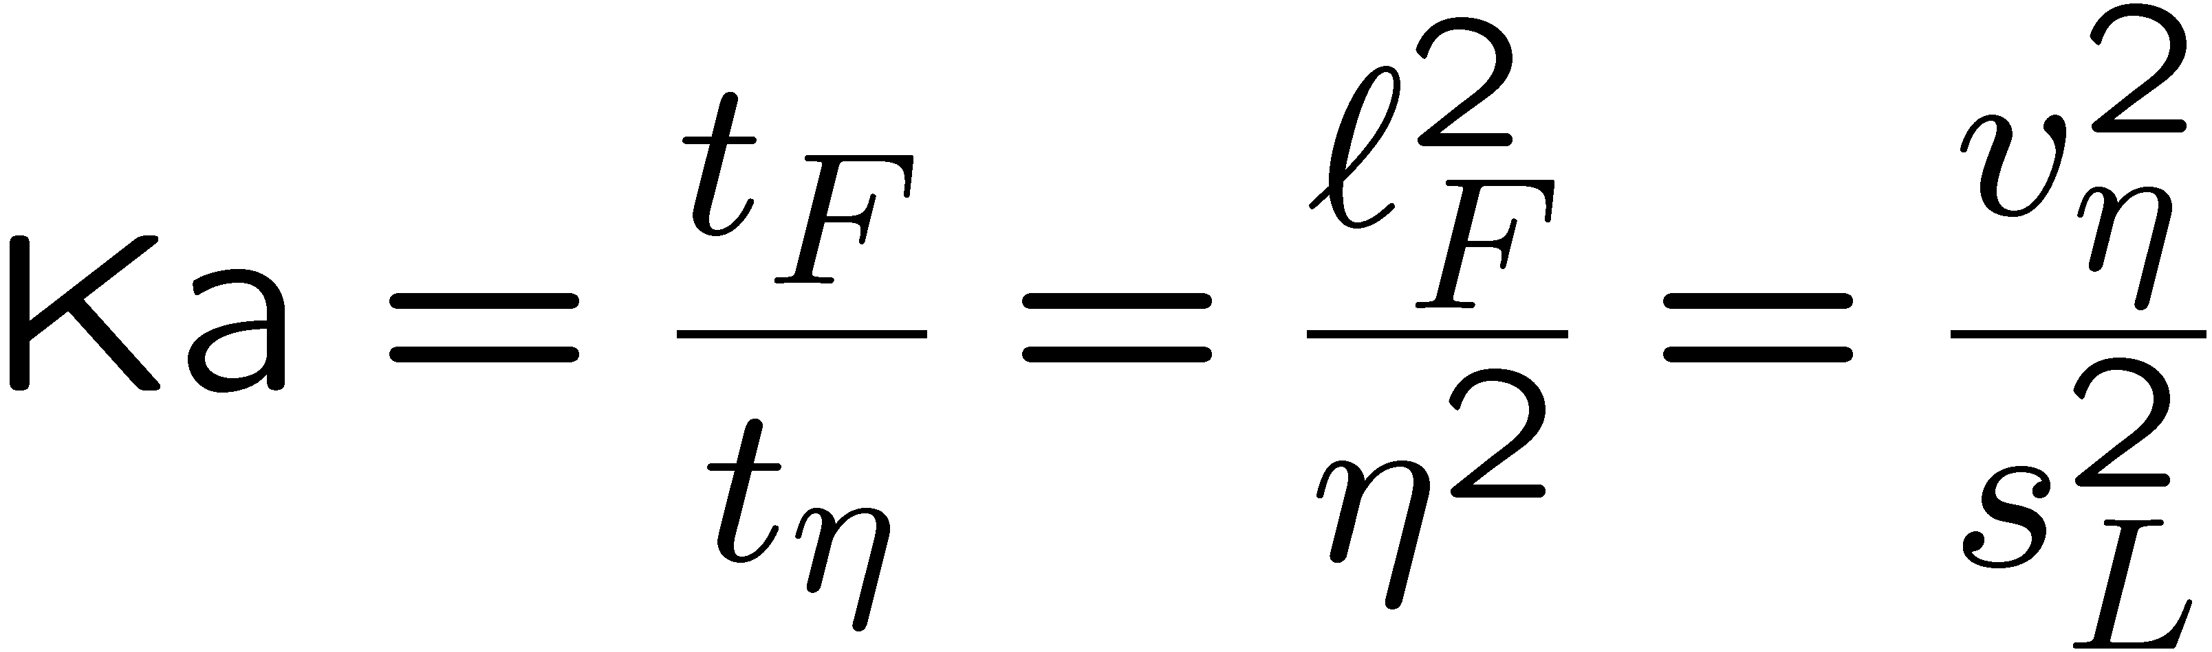
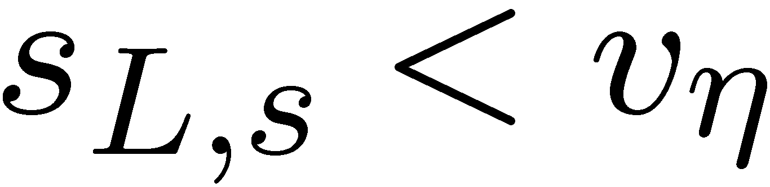
In flames D/ν is also of order unity.
However, since s_{L,s} is of the same order of magnitude as s_{L},
The definition
shows that the ratio s_{L,s}/v_{η} is proportional to Ka^{-1/2}.
Since Ka > 1 in the thin reaction zones regime it follows that
in that regime.
The propagation term therefore is small and the curvature term will be dominant.
12.-37

Slide 5
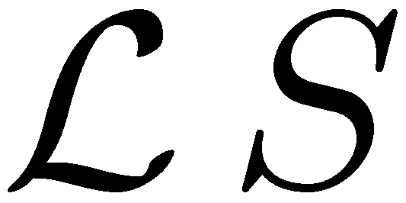
We want to base the following analysis on an equation which contains only the leading order terms in both regimes.
Therefore we take the propagation term with a constant laminar burning velocity s_{L}⁰ from the corrugated flamelets regime and the curvature term multiplied with the diffusivity D from the thin reaction zones regime.
The strain term will be neglected in both regimes.
12.-38

Slide 6
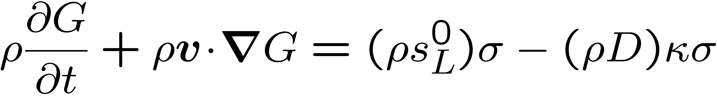
The leading order equation valid in both regimes then reads
For consistency with other field equations that will be used as a starting point for turbulence modeling, we have multiplied all terms in this equation with ρ. This will allow to apply Favre averaging to all equations.
Furthermore, we have set ρ s_{L}⁰ = ρ_{u} s_{L,u} constant and denoted this by paranthesis.
12.-39

Slide 7
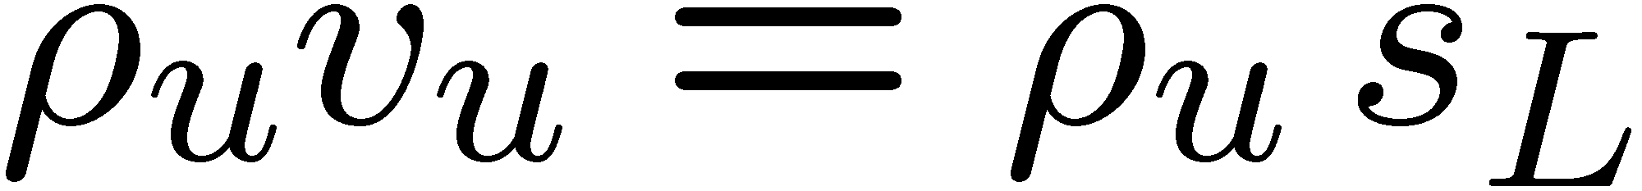
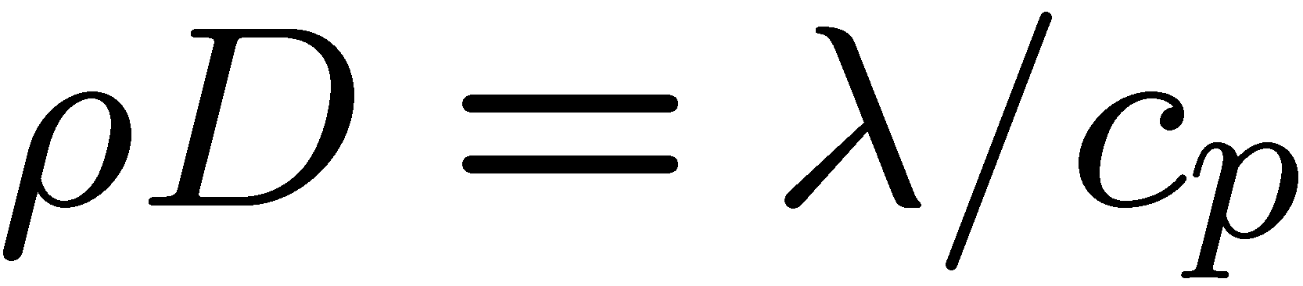
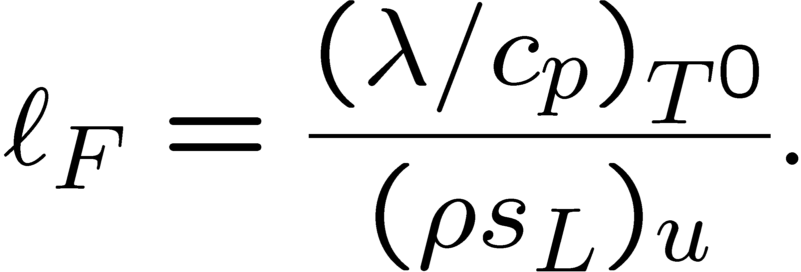
This takes into account that the mass flow rate ρs_{L}⁰ through a planar steady flame is constant as shown by
The paranthesis of ρD also denote that this product was assumed constant in deriving
There it was defined at T⁰, and since
it is equal to λ/c_{p0} used in the definition of the flame thickness
12.-40

Slide 8
Modeling Premixed Turbulent Combustion Based on the Level Set Approach
If the G-equation is to be used as a basis for turbulence modeling, it is convenient to ignore at first its non-uniqueness outside the surface G(x, t) = G₀.
Then the G-equation would have similar properties as other field equations used in fluid dynamics and scalar mixing.
This would allow to define, at point x and time t in the flow field, a probability density function P(G;x,t) for the scalar G.
12.-41

Slide 9
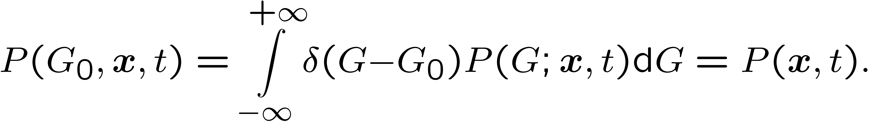
This is the probability density of finding the flame surface G(x,t)=G₀ at x and t given by
This quantity can be measured, for instance, by counting the number of flame crossings in a small volume ΔV located at x over a small time difference Δt.
12.-42

Slide 10
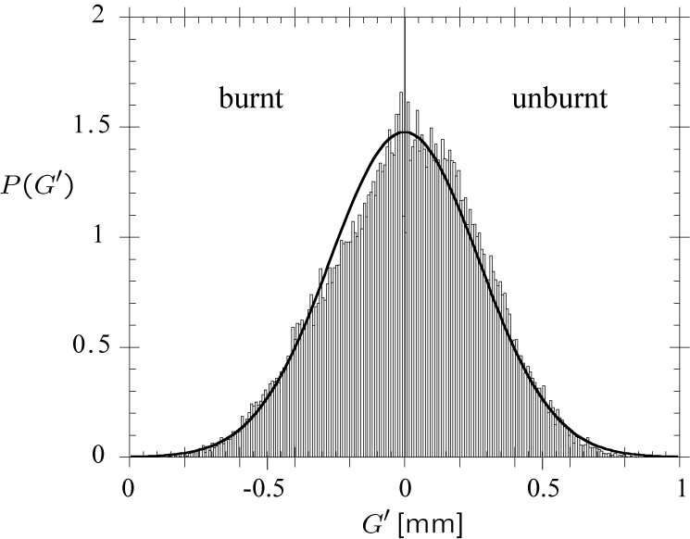
Experimental data for the pdf (Wirth et al., 1992, 1993) from a transparent spark-ignition engine.
Smoke particles, which burnt
out immediately in the flame
front, were added to the
unburnt mixture.
Thereby the front could be
visualized by a laser sheet as
the borderline of the region
where Mie scattering of
particles could be detected.
The pdf represents the pdf of
fluctuations around the mean flame contour of several instantaneous images.
12.-43

Slide 11
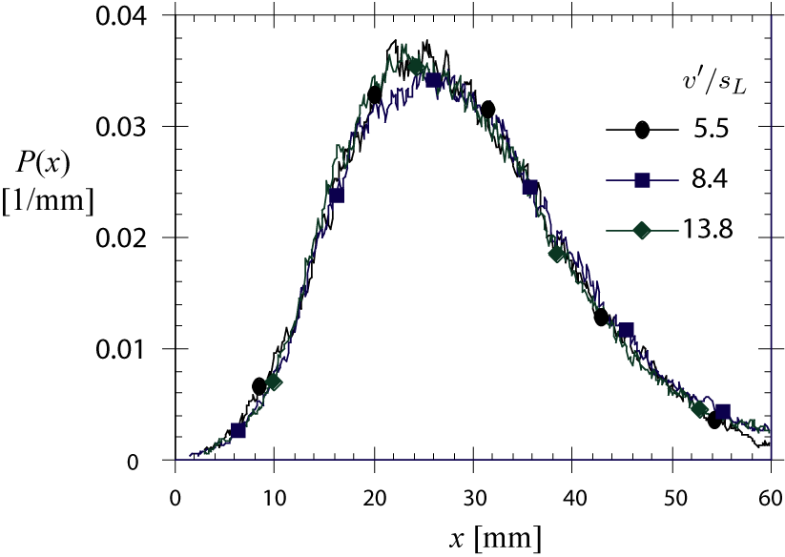
Plessing et al. (1999) have measured the probability density of finding the flame surface in steady turbulent premixed flames on a weak swirl burner.
The flames were stabilized
nearly horizontally on
the burner thus
representing
one-dimensional
steady turbulent flames.
Temperature data obtained
from Rayleigh scattering are
averaged. The three profiles
of P(x), for three velocity ratios v'/s_{L}, nearly coincide and are slightly skewed towards the unburnt gas side.
12.-57

Slide 12
By comparing the measured pdf with a Gaussian distribution it is seen to
be slightly skewed to the unburnt gas side.
This is due to the non-symmetric influence of the laminar burning velocity on the shape of the flame front:
there are rounded leading edges towards the unburnt mixture, but sharp and narrow troughs towards the burnt gas.
This non-symmetry is also found in other experimental pdfs.
12.-44

Slide 13
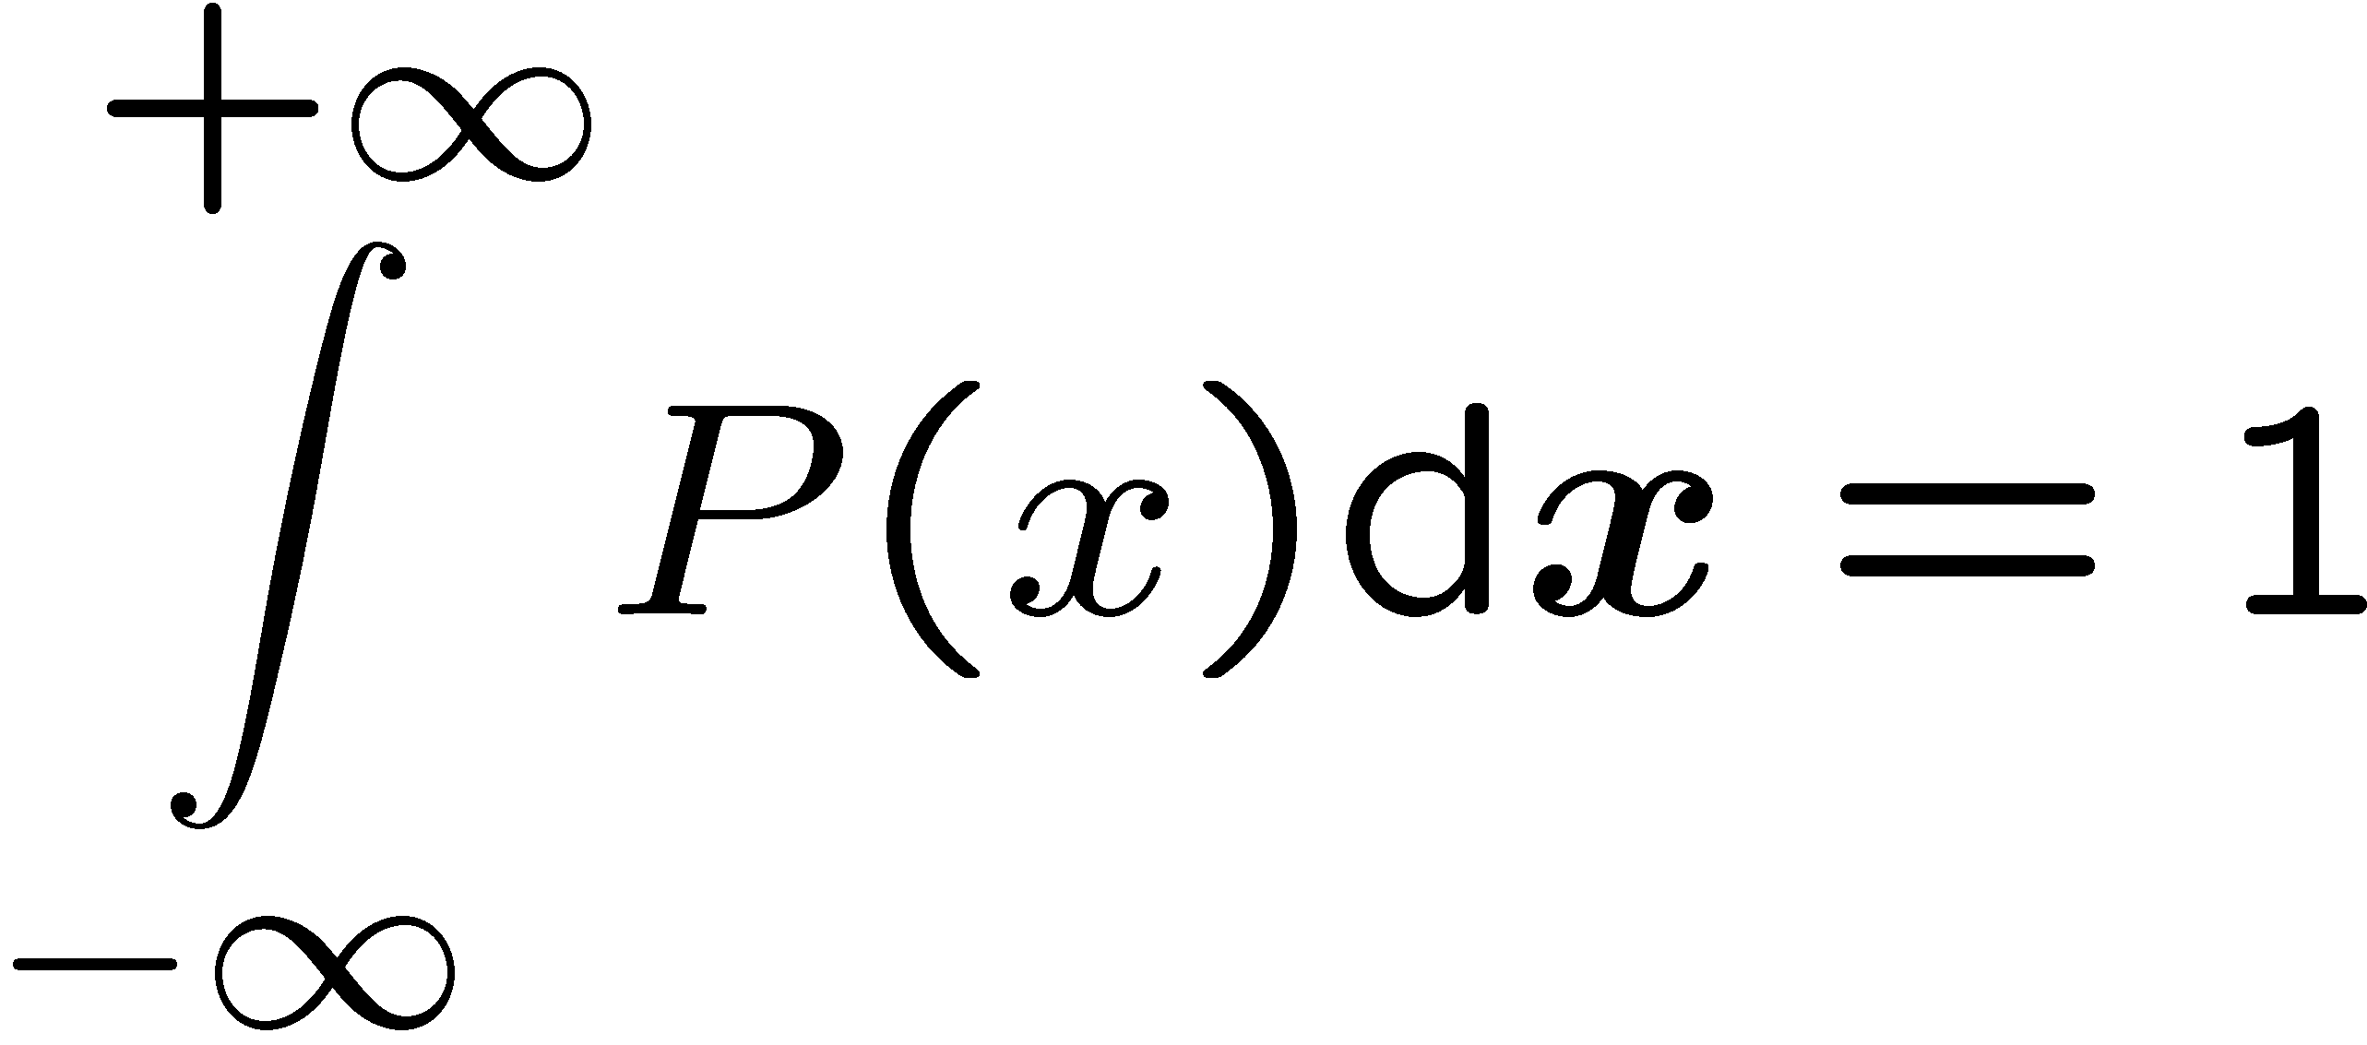
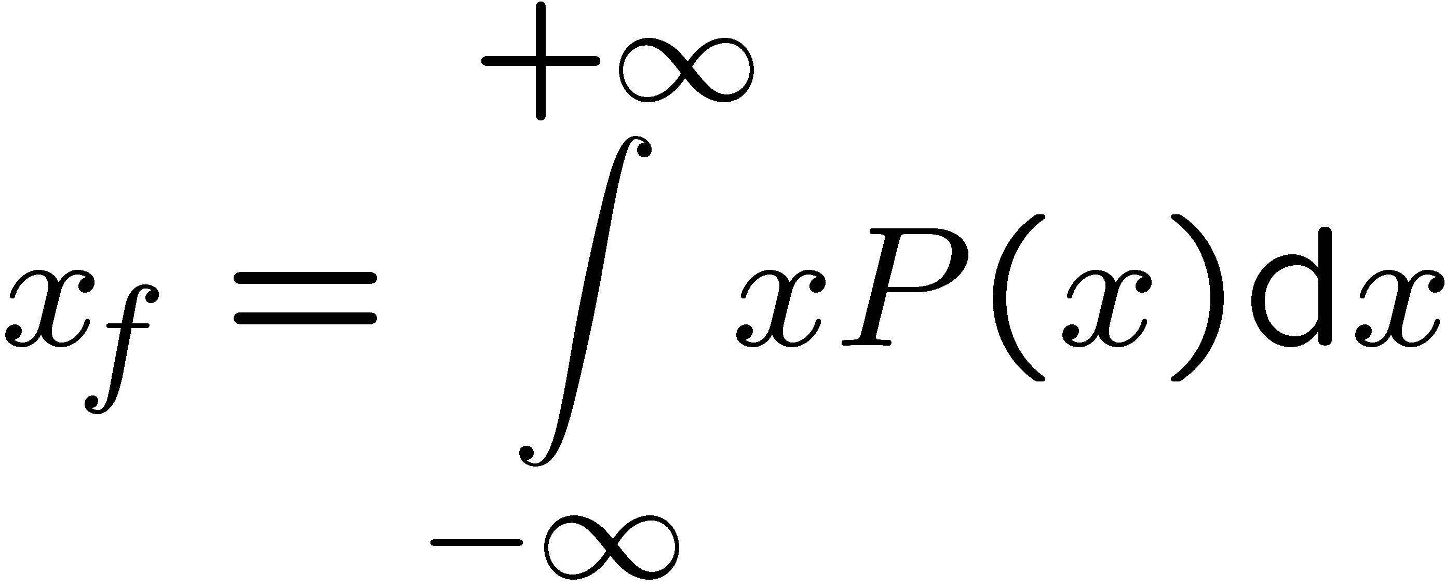
Without loss of generality, we now want to consider a one-dimensional steady turbulent flame propagating in x-direction.
We will analyze its structure by introducing the flame-normal coordinate x,
such that all turbulent quantities are a function of this coordinate only.
Then the pdf of finding the flame surface at a particular location x within the flame brush simplifies to P(G₀; x) which we write as P(x).
We normalize P(x) by
and define the mean flame position x_{f} as
12.-45

Slide 14
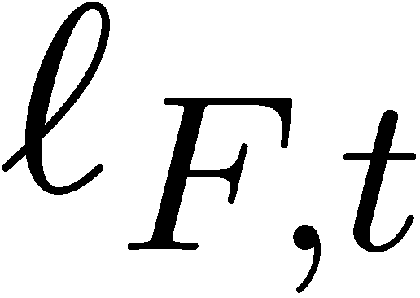
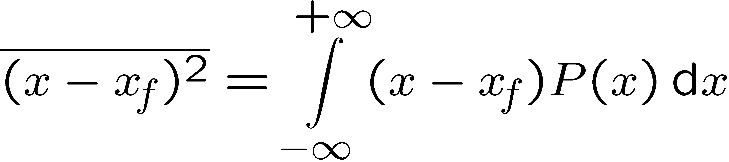
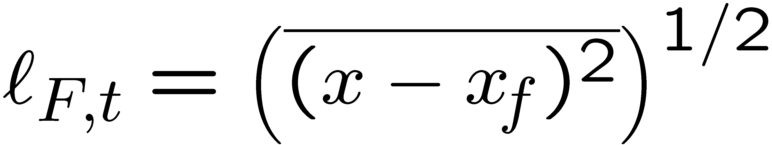
The turbulent flame brush thickness can also be defined using P(x).
With the definition of the variance
a plausible definition is
We note that from P(x) two important properties of a premixed turbulent flame, namely the mean flame position and the flame brush thickness can be calculated.
12.-46

Slide 15
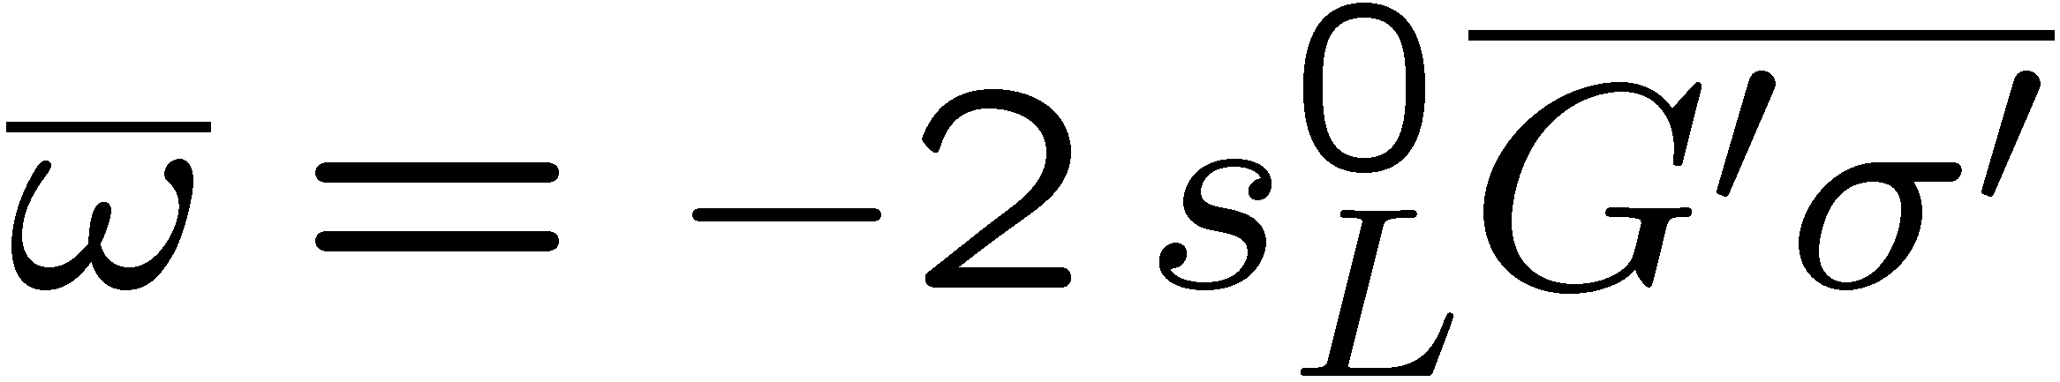
Peters (1992) considered turbulent modeling of the G-equation in the corrugated flamelets regime and derived Reynolds-averaged equations for the mean and the variance of G.
The main sink term in the variance equation was defined as
This quantity was called kinematic restoration in order to emphasize the effect of local laminar flame propagation in restoring the G-field and thereby the flame surface.
Corrugations produced by turbulence, which would exponentially increase the flame surface area with time of a non-diffusive iso-scalar surfaceare restored by this kinematic effect.
12.-47

Slide 16
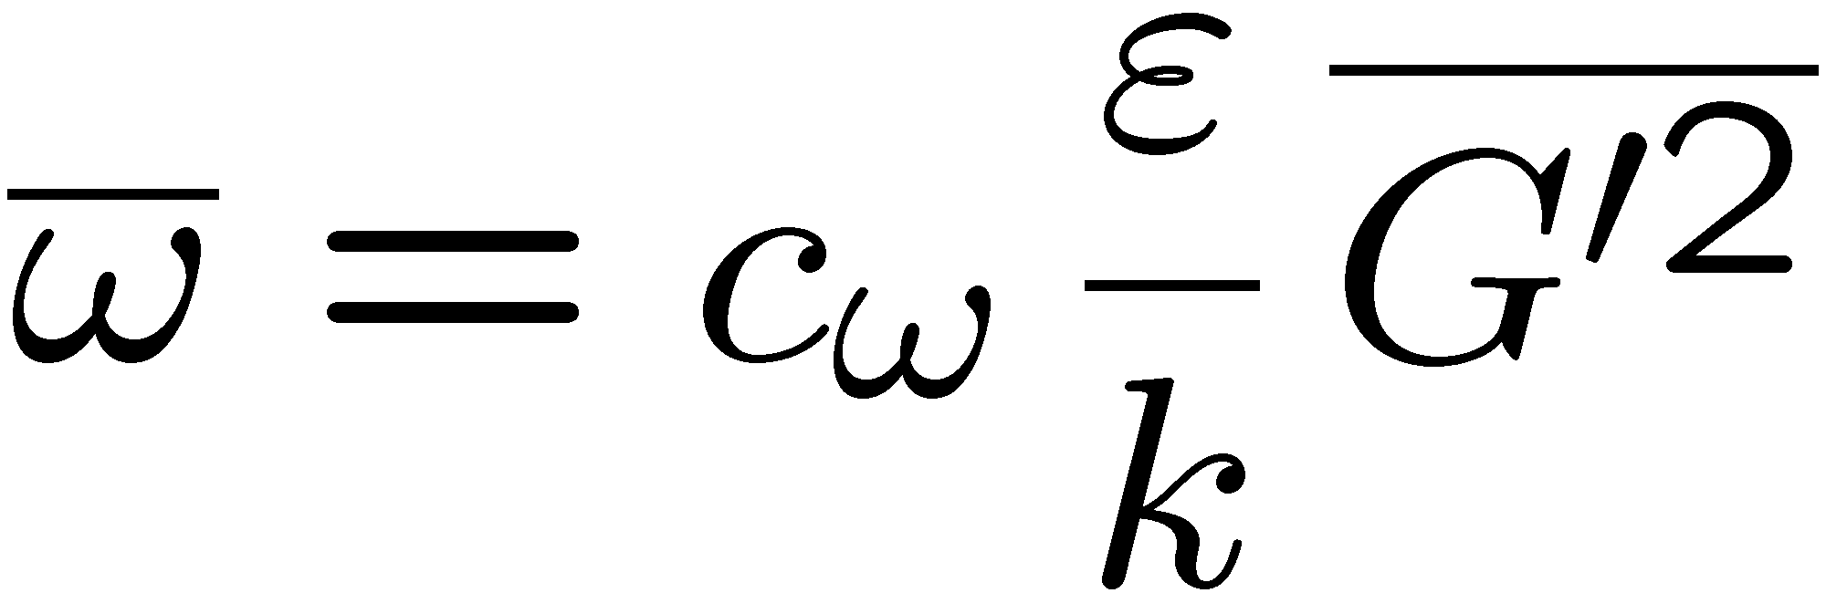
From that analysis resulted a closure assumption which relates the main sink term to the variance of G and the integral time scale
where c_{ω}=1.62 is a constant of order unity.
This expression shows that kinematic restoration plays a similar role in reducing fluctuations of the flame front as scalar dissipation does in reducing fluctuations of diffusive scalars.
It was also shown by Peters (1992) that kinematic restoration is active
at the Gibson scale, since the cut-off of the inertial range in the scalar spectrum function occurs at that scale.
12.-48

Slide 17
Equations for the Mean and the Variance of G
In order to obtain a formulation that is consistent with the well-established use of Favre averages in turbulent combustion, we split G and the velocity vector v into Favre means and fluctuations
Here the Favre means are at first viewed as unconditional averages.
At the end, however, only the respective conditional averages are of interest.
12.-49

Slide 18
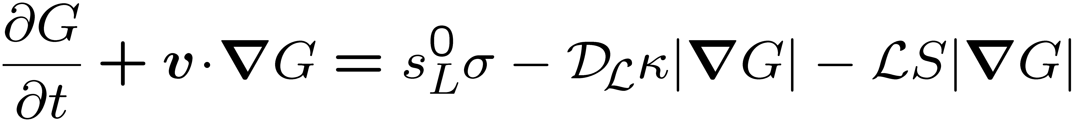
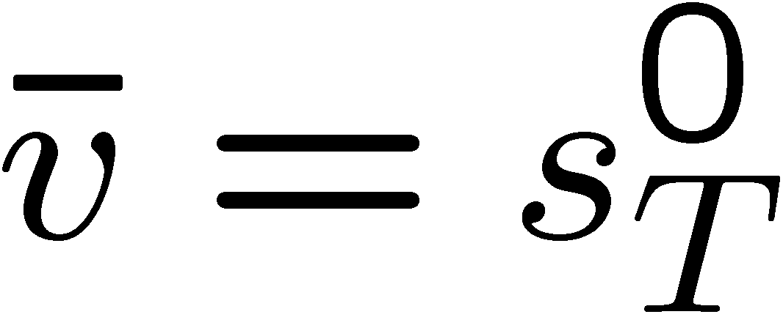
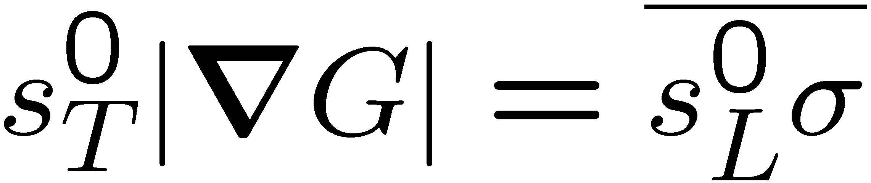
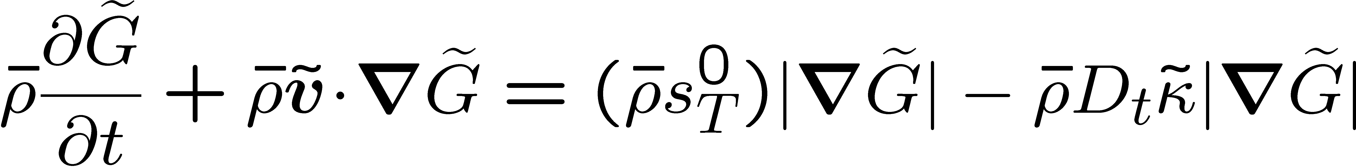
The turbulent burning velocity s_{T}⁰ is obtained by averaging over
By setting one finds for the stationary unstretched flame front
Using a number of additional closure assumptions described in Peters (2000), one finally obtains the following equations for the Favre near and variance of G:
12.-50

Slide 19
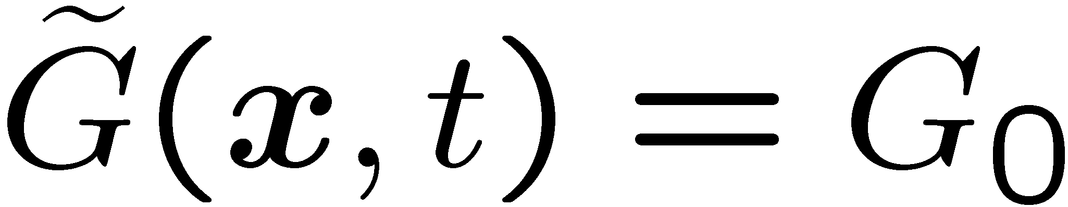
It is easily seen that
has the same form as
and therefore shares its mathematical properties.
It also is valid at only.
The solution outside of that surface depends on the ansatz for the Favre mean of G that is introduced.
12.-51

Slide 20

In order to solve
a model for the turbulent burning velocity s⁰_{T} must be provided.
A first step would be to use empirical correlations from the literature.
Alternatively, a modeled balance equation for the mean gradient will be derived.
According to Kerstein (1988) this quantity represents the flame surface area ratio, which is proportional to the turbulent burning velocity.
12.-52

Slide 21
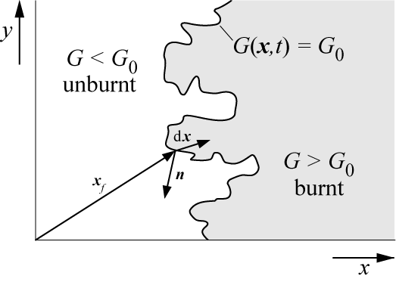
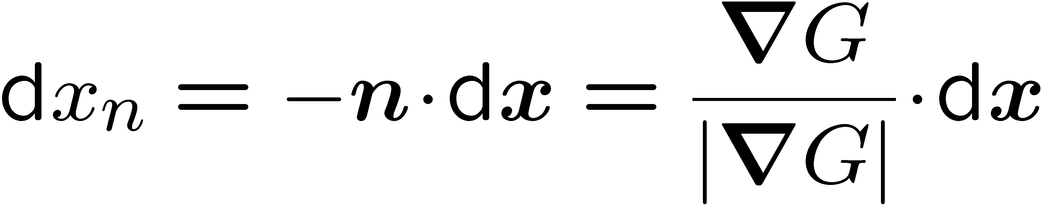
In this respect G(x,t) differs fundamentally from the mixture fraction Z(x,t) used in nonpremixed combustion, which is a conserved scalar that is well defined in the entire flow field.
The distance x_{n} from the flame surface in normal direction, however, can be uniquely defined by introducing its differential increase towards the burnt
gas side by
Here dx is a differential vector pointing
from the front to its surroundings.
12.-7

Slide 22
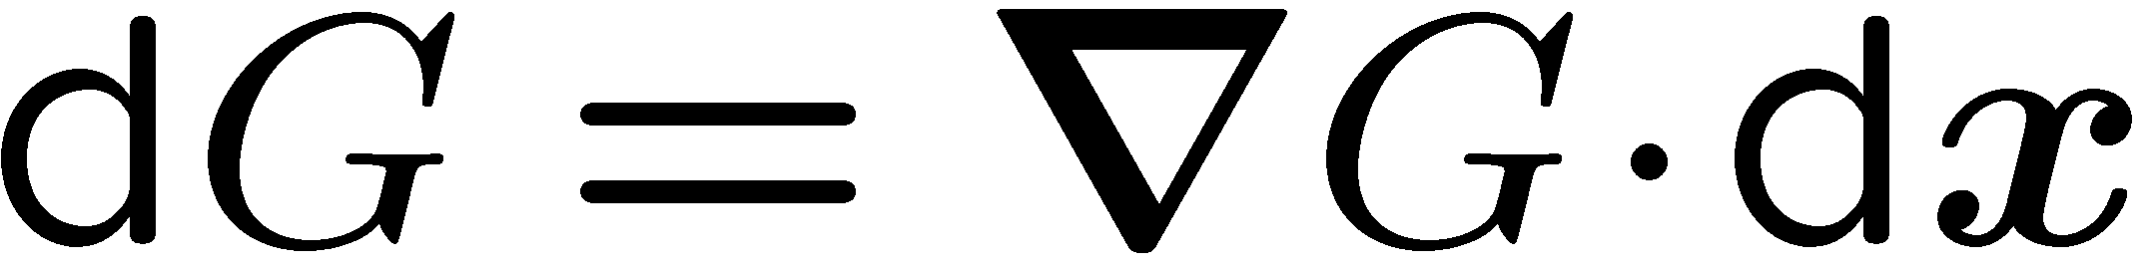
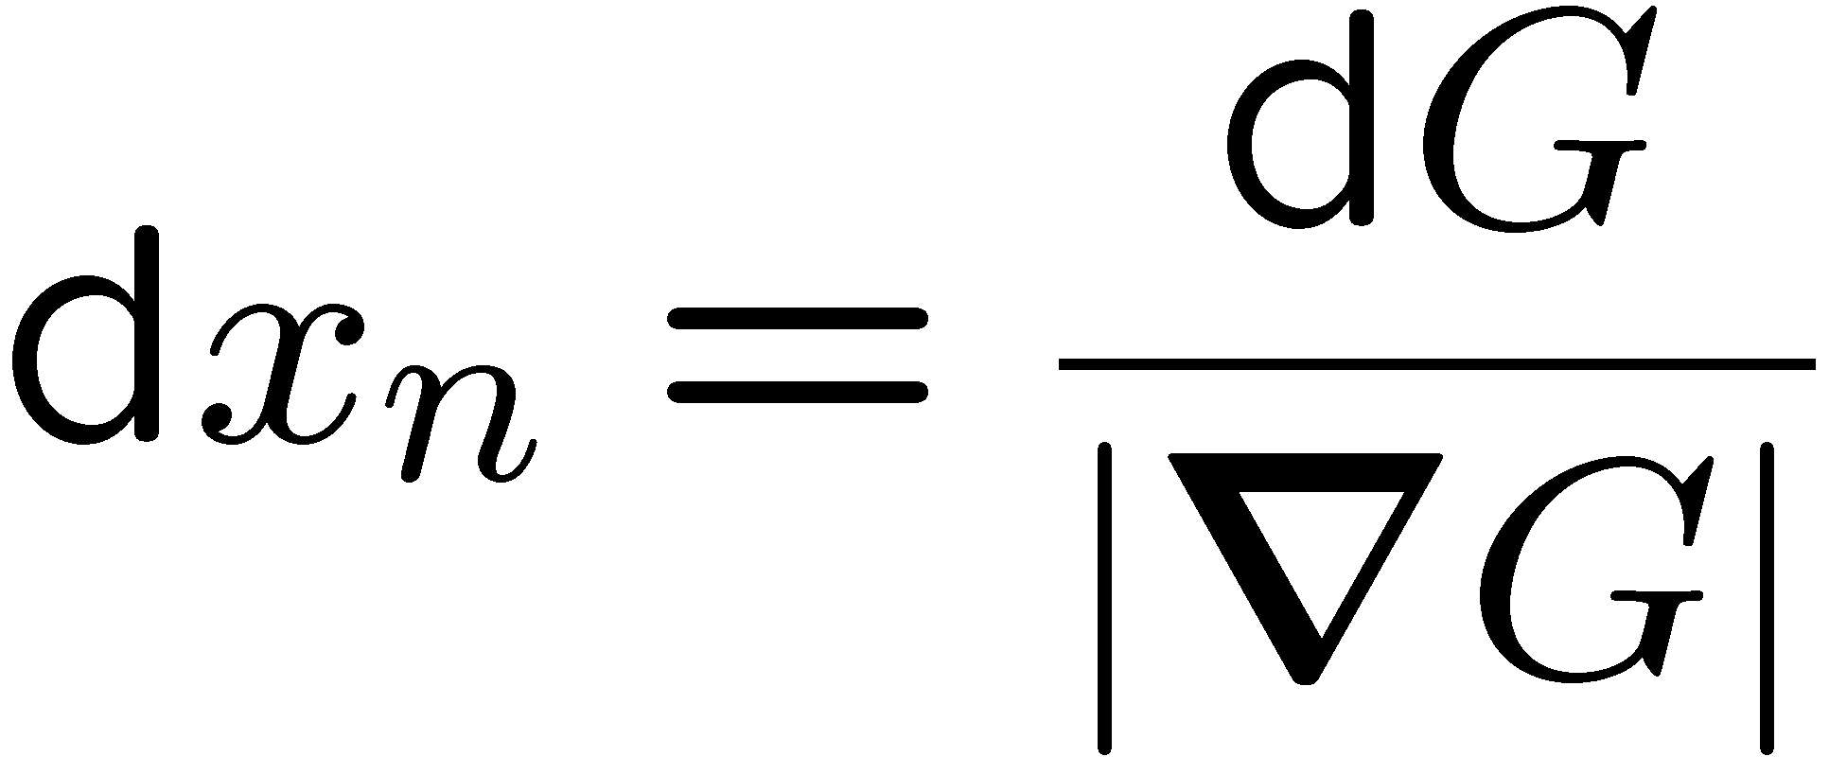
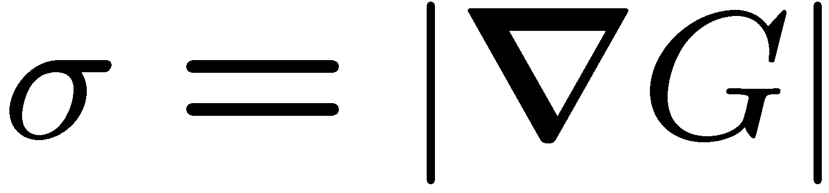
If we consider a frozen G-field, a differential increase of the
G-level is given by
Introducing this into
it is seen that the differential increase
dx_{n} is related to dG by
In the following the absolute value
of the gradient of G at G(x,t)=G₀ will be
denoted by
12.-8

Slide 23
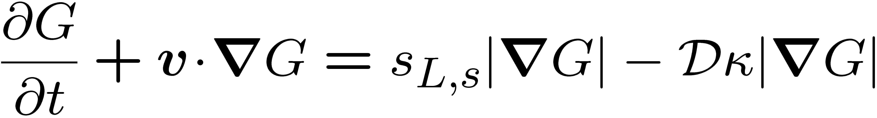
A similar analysis was performed by Peters (1999) for the thin reaction zones
regime.
In that regime the diffusion term in
is dominant as shown by the order of magnitude analysis of
12.-66

Slide 24
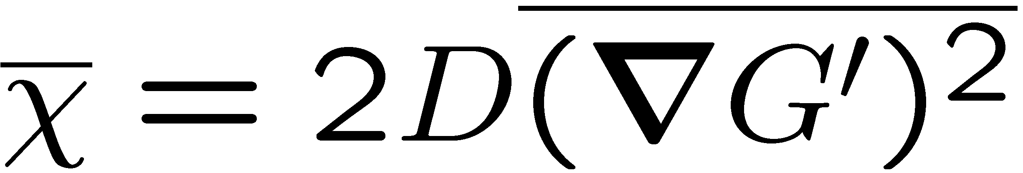
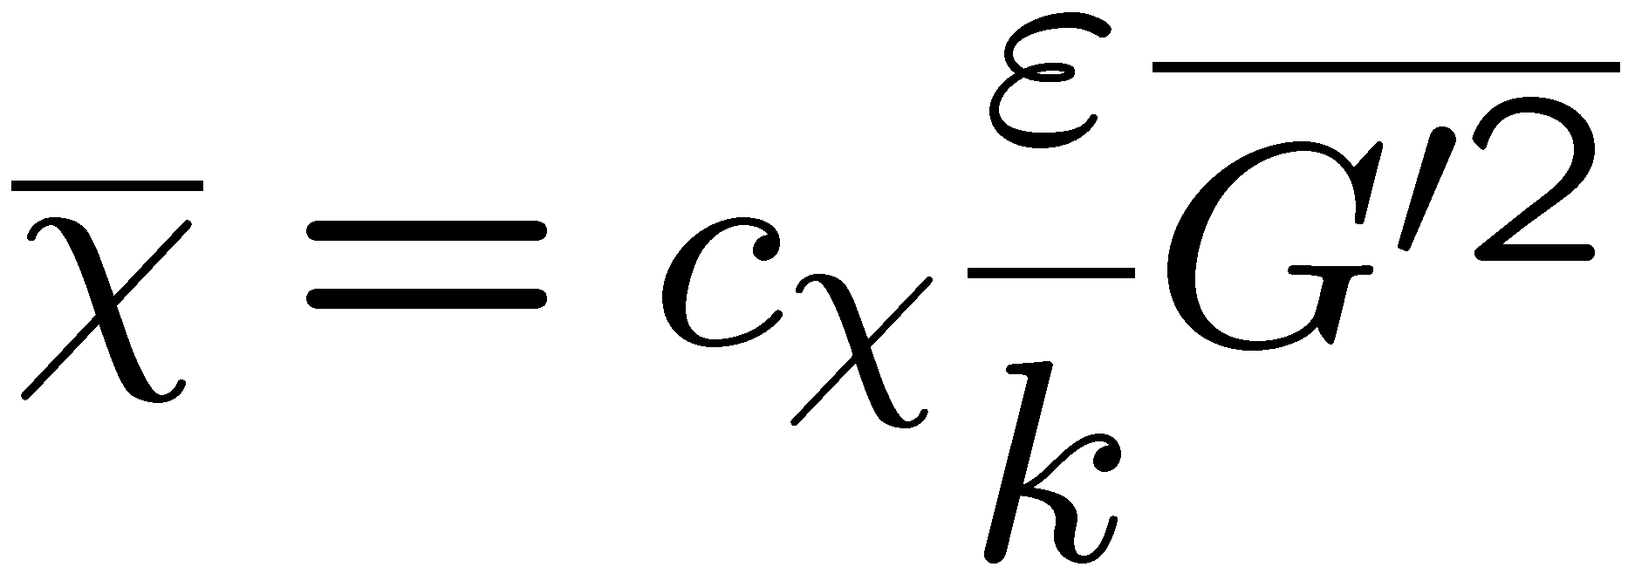
This leads to a dissipation term replacing kinematic restoration as the leading order sink term in the variance equation. It is defined as
Closure of that term is obtained in a similar way as for non-reacting scalars and leads to
Below we will use the two closure relations
and
as the basis for the modeling of the turbulent burning velocity in the two different regimes.
12.-50

Slide 25
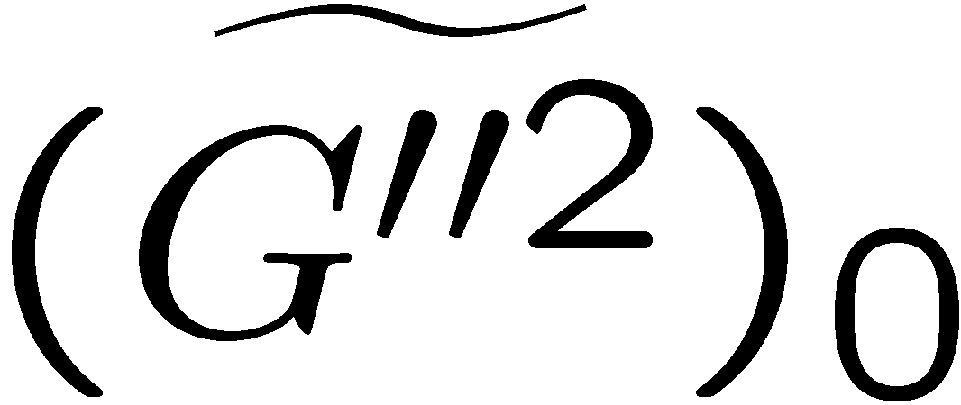
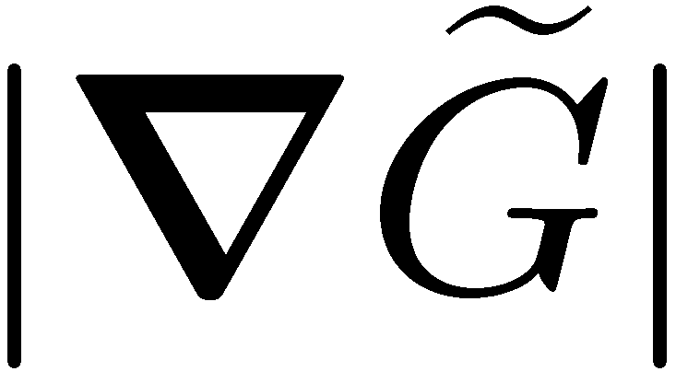
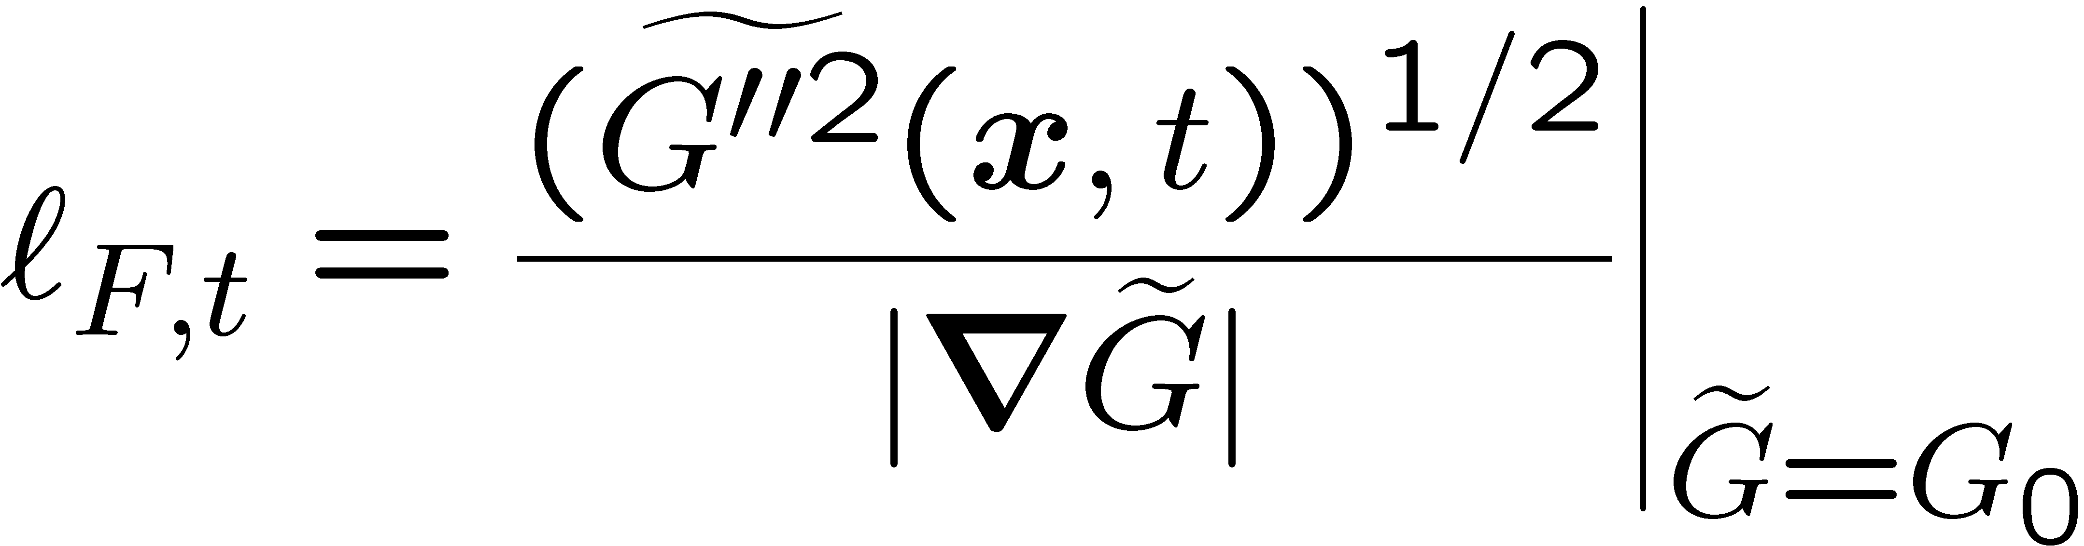
Let us consider the equation for the variance
since the variance is a property of the flame front.
The solution of that equation will provide the conditional value at the mean flame surface.
Following
its square root is a measure of the flame brush thickness, which for an arbitrary value of at the front, will be defined as
12.-72

Slide 26
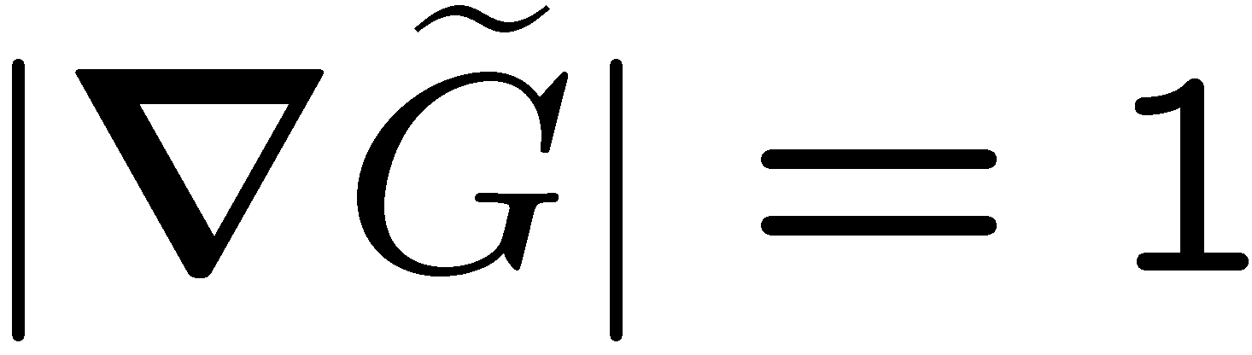
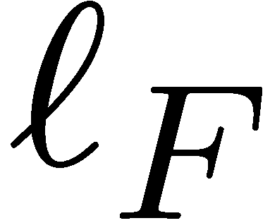
An Example Solution for the Turbulent Flame Brush Thickness
For illustration purpose we want to solve the variance equation
for a one-dimensional unsteady planar flame using
We pose the problem such that at time t = 0 a one-dimensional steady laminar flame with flame thickness is already present and that the laminar flow is suddenly replaced by a fully developed turbulent flow field.
We assume that the turbulence diffusivity D_{t}, the Favre mean turbulent kinetic energy and its dissipation are constant, independent of time.
12.-74

Slide 27
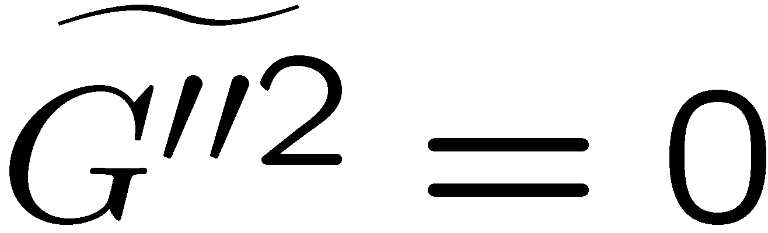
Since the flame is planar and, furthermore, since the variance must not depend on the coordinate normal to the mean flame, if it is supposed to represent the conditional variance, all gradients of G-variance must vanish.
Therefore, the convective and diffusive terms in
disappear entirely.
For modeling purposes we will use a turbulent Schmidt number Sc_{t}=ν_{t}/D_{t}=0.7
12.-75

Slide 28
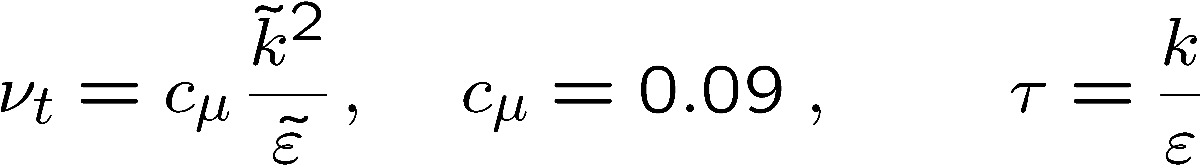
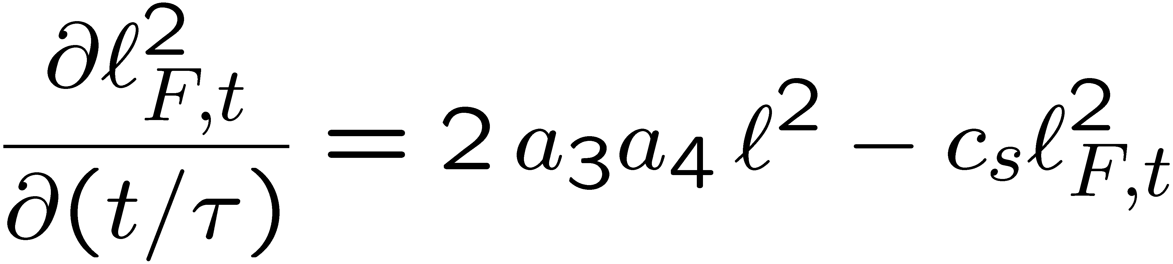
The empirical values follow from Eqs.
and relate the turbulent quantities to the velocity fluctuations, the flame thickness and the turbulent time scale.
Non-dimensionalizing the time in
by the integral time scale, the variance equation becomes an equation for the turbulent flame brush thickness
12.-77

Slide 29
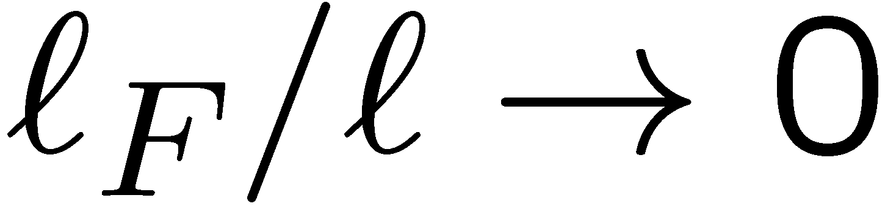
The equation for the turbulent flame brush thickness has the solution
where
Here the laminar flame thickness was used as initial value.
In the limit one obtains
12.-78

Slide 30
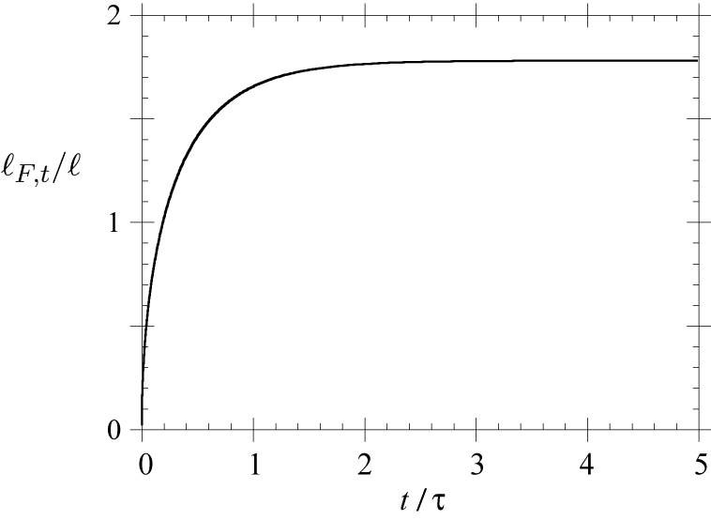

The unsteady development of the flame brush thickness in the limit
For large times it
becomes proportional
to the integral length
scale .
12.-79

